Slide 1
Software Engineering and Professional Practice. Building Usable Software. Unit 7: Software Project Management Part 1: Introduction
Anis Zarrad
a.zarrad@bham.ac.uk

Slide 2
Outlines
Introduction
Project initiation
Project Planning
Project Execution
Monitor and Control
Project Closure

Slide 3
Learning objectives
Describe the five project management process groups.
Apply PM process groups to manage a software and understand the contribution that effective project initiation, project planning, project execution, project monitoring and controlling, and project closing make to project success.
Notes:
.

Slide 4
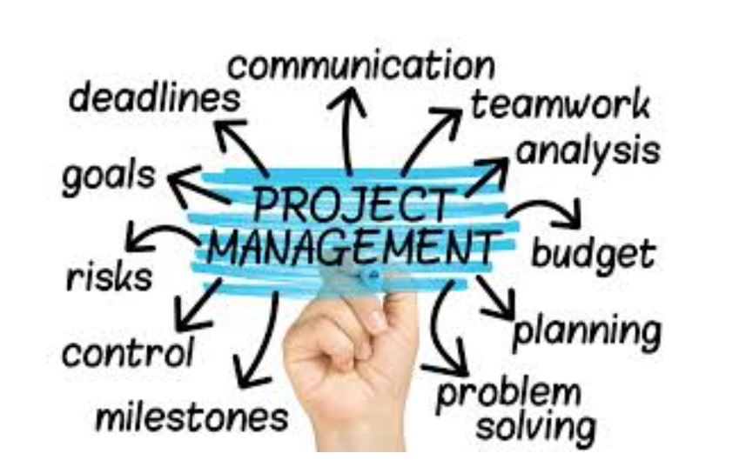

Slide 5
Introduction
Software project management is aimed to ensure that the software is delivered on time, within budget and schedule constraints, and satisfies the requirements of the client
Management of software projects is different from other types of management because:
Software is not tangible
Software processes are relatively new and still “under trial”
Larger software projects are usually “one-off” projects
Computer technology evolves very rapidly

Slide 6
Project / Program/ portfolio
A project is a temporary endeavor undertaken by a company or organization (such as the creation of a new product, service, or result)
A program is a group of projects that are similar or related to one another, and which are often managed and coordinated as a group instead of independently
A portfolio is a group of different programs and/or projects within the same organization, which may be related or unrelated to one another

Slide 7
Effective SW project management focuses on 3 P’s:
people
problem
process

Slide 8
Phases of project management
Project Initiating.
Project Planning.
Project Execution.
Project Monitoring and Control.
Project Closure.

Slide 9
Project Management Process Groups
Planning
Project deliverables
Closing
Inputs
Initiation
Executing
Project Documents
Monitor and Control

Slide 10
Planning
Closing
Initiation
Executing
Monitor and Control

Slide 11
Project Initiation
Initiating a project includes recognizing and starting a new project or project phase
Some organizations use a pre-initiation phase, while others include items like developing a business case as part of initiation
The main goal is to formally select and start off projects
Key outputs include:
Assigning the project manager
Identifying key stakeholders
Completing a business case
Completing a project charter and getting signatures on it

Slide 12
Project Initiation Documents
Business case
Document that describes information of a particular business to determine if the project is worth the investment.
Charter
Document issued by the project initiator or sponsor that formally authorizes the existence of a project, and provides the project manager with the authority to apply organizational resources to project activities.” (PMI, 2004, 368)

Slide 13
Planning
Closing
Initiation
Executing
Monitor and Control

Slide 14
Project Plan
A project plan should be drawn at the start of the project. This plan drives the project and needs to be continuously adjusted
The role of the project manager is to anticipate possible problems and be prepared with solutions for these problems
Other plans that need be developed:
Quality plan
Validation and verification plan
Configuration management plan
Maintenance plan
Testing Plan
Staff development plan

Slide 15
Project planning process
An iterative process that starts when you create an initial project plan during the project startup phase.
Plan changes are inevitable:
more information about the system and the project team becomes available.
changing business goals also leads to changes in project plans.

Slide 16
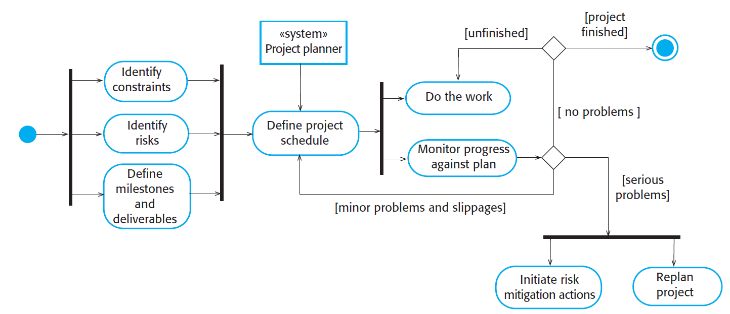
Project planning process

Slide 17
Work Breakdown Structure (WBS)
Project plan Involves breaking down the work (WBS) into parts and assign these to project team members, anticipate problems that might arise and prepare tentative solutions.
Items:
Work packages
coherent amount of work that can be assigned to a team or contracted out. represents the “contract” between project manager and team leader.
always ends with a milestone
Tasks/activities
Un-decomposable amount of work that can be done by an individual.
Milestones
points in the schedule against which you can assess progress, for example, the handover of the system for testing
Deliverables
work products that are delivered to the customer.

Slide 18
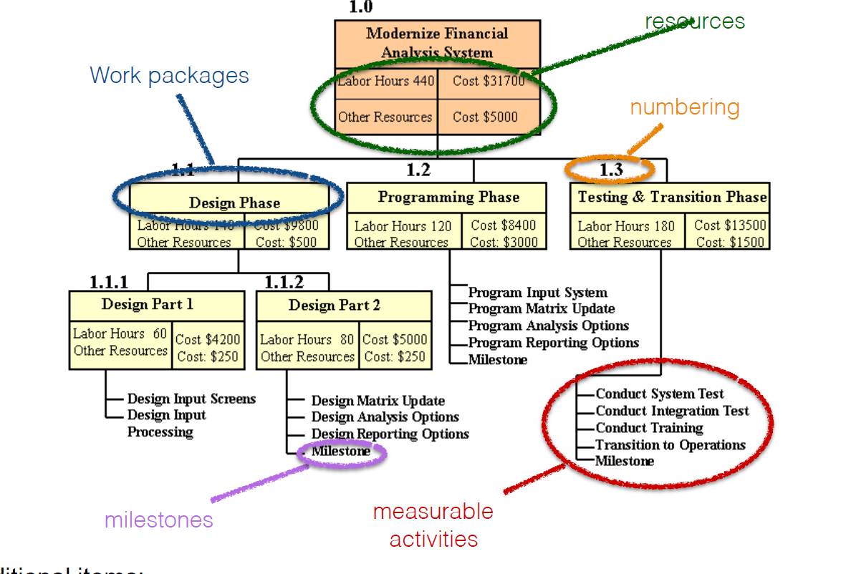
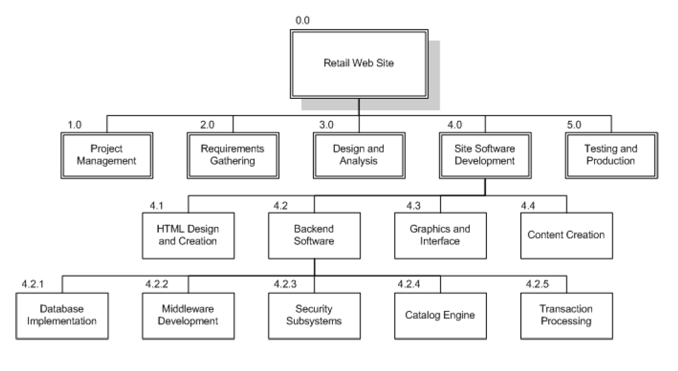
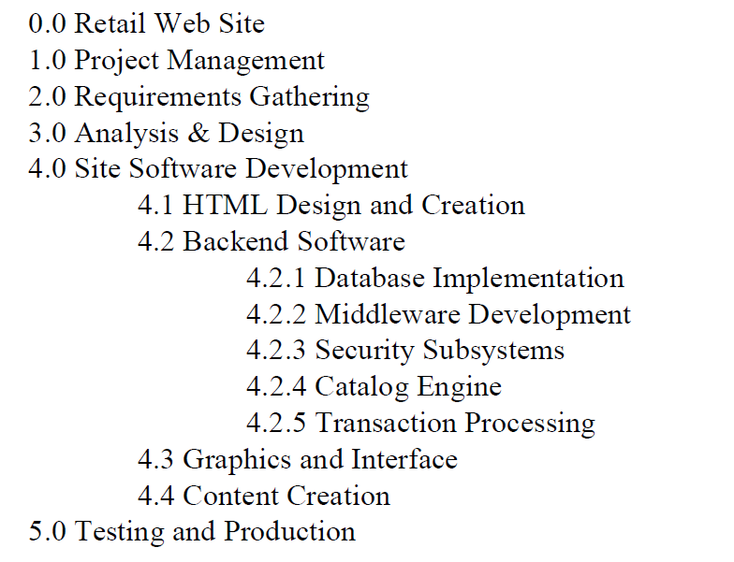
WBS - Example

Slide 19

Example Software Milestones
Task 1: Brainstorm ideas. Task 2: Create a presentation. Milestone 1: Presentation approved.

Slide 20
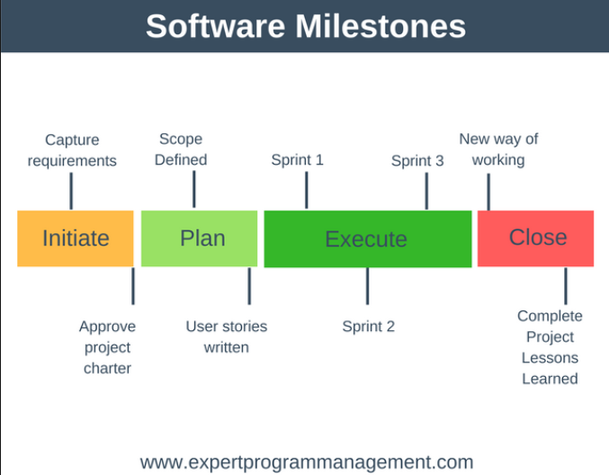

Slide 21
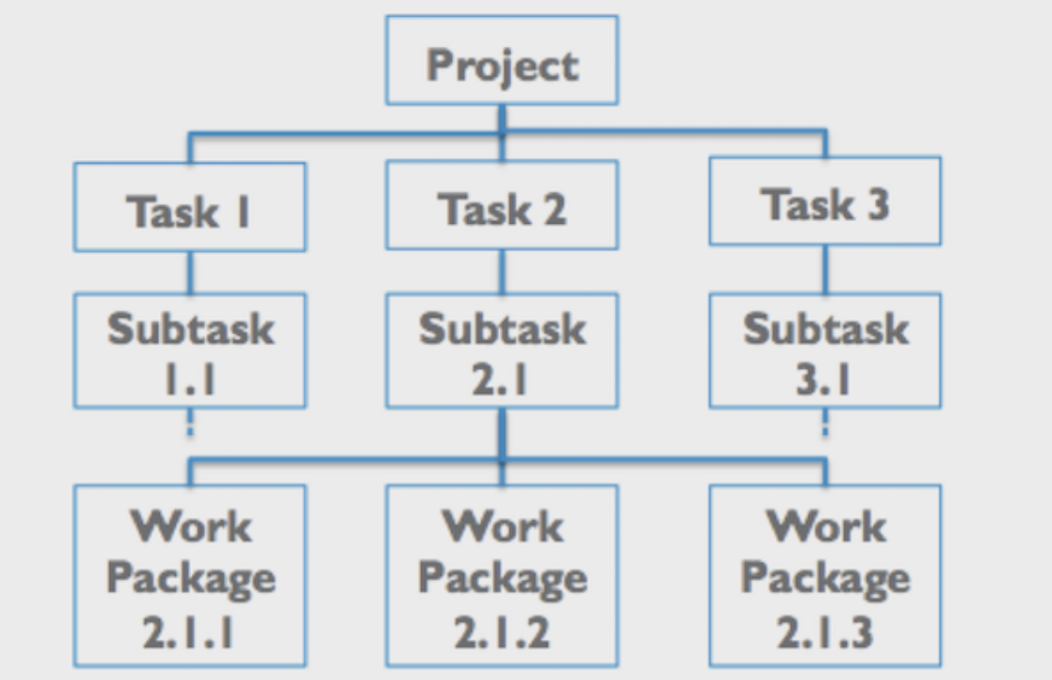
WBS Typical Example

Slide 22
Software Engineering and Professional Practice. Building Usable Software. Unit 6: Software Project Management Part 2: Project Scheduling
Anis Zarrad
a.zarrad@bham.ac.uk

